Slide 1
Cultural identity
Kaelin staats

Slide 2
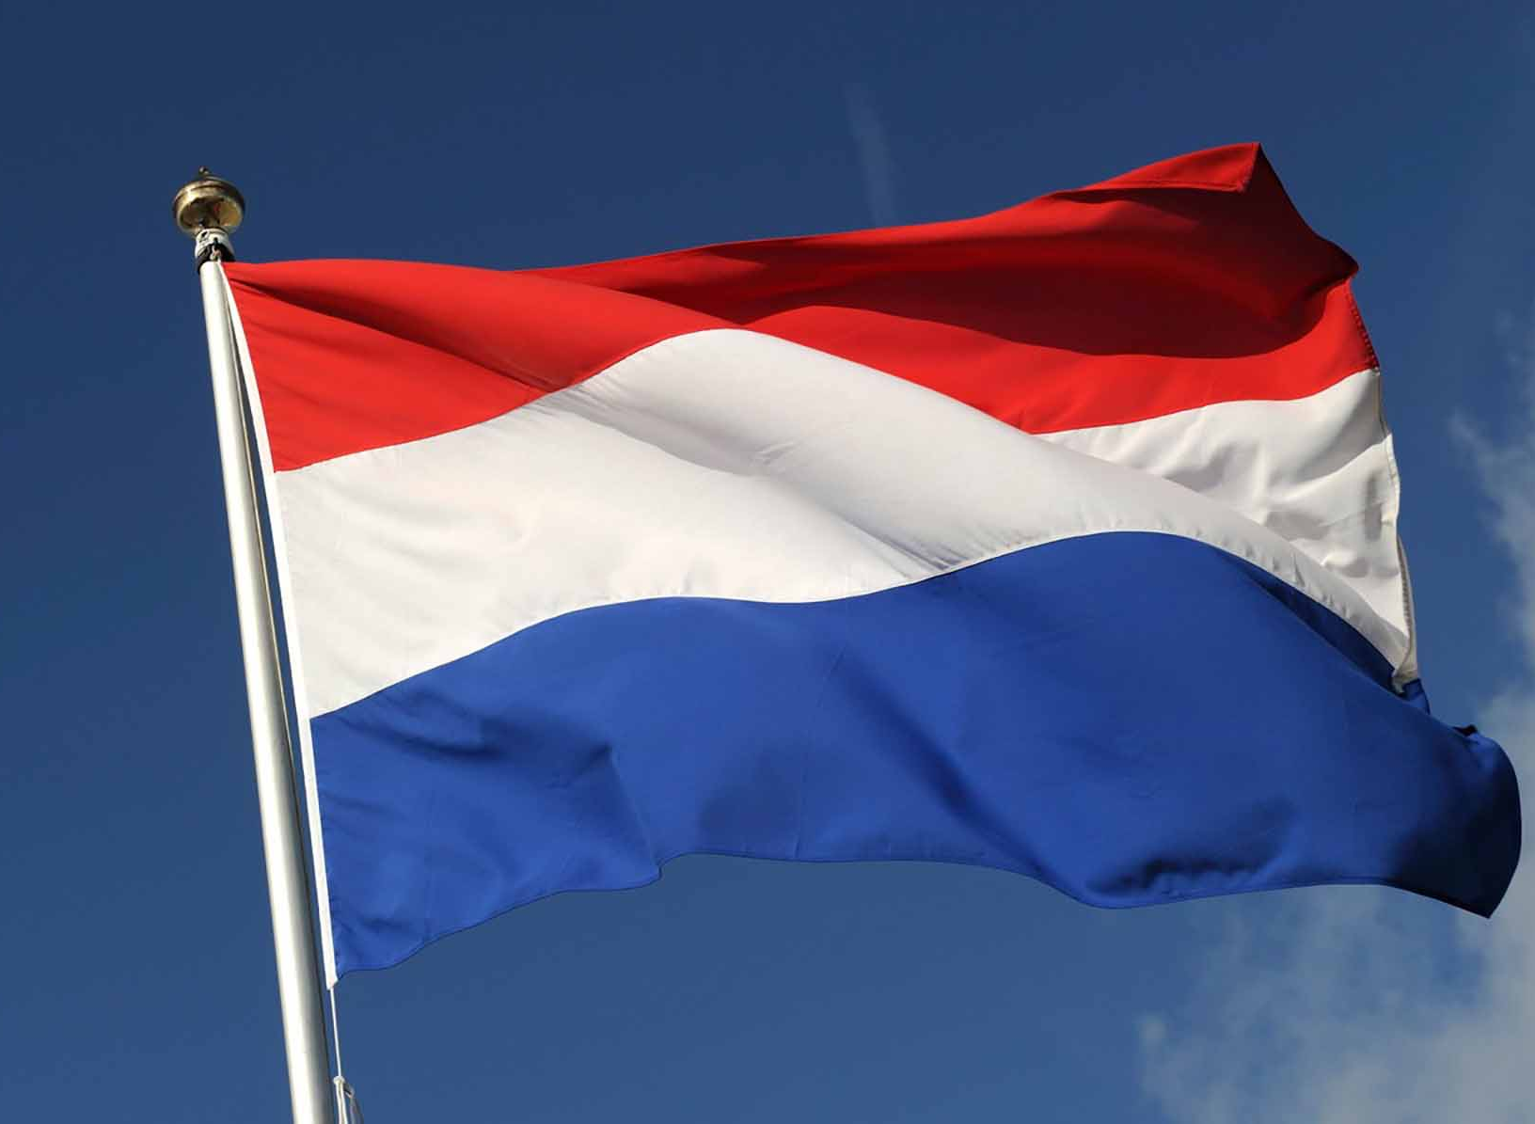
National symbols
Wilhemus → National hymne
Dutch flag
Orange as the national color

Slide 3
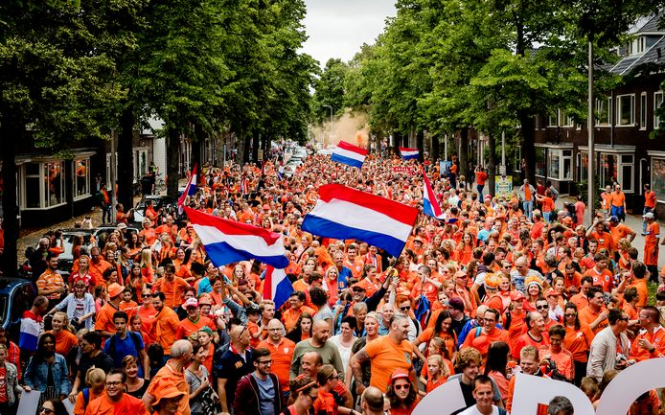
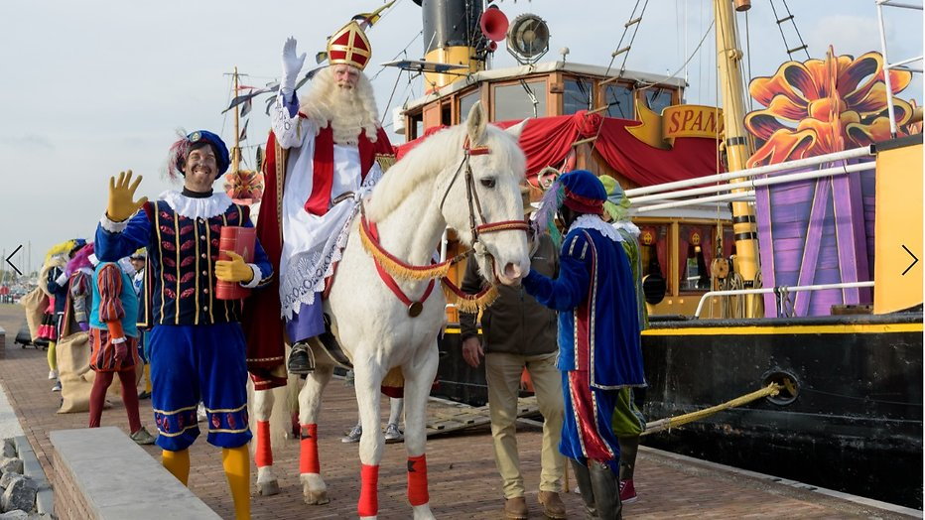
Traditions and holidays
Kingsday
Sinterklaas
Dodenherdenking + bevrijdingsdag (4th and 5th of may)

Slide 4
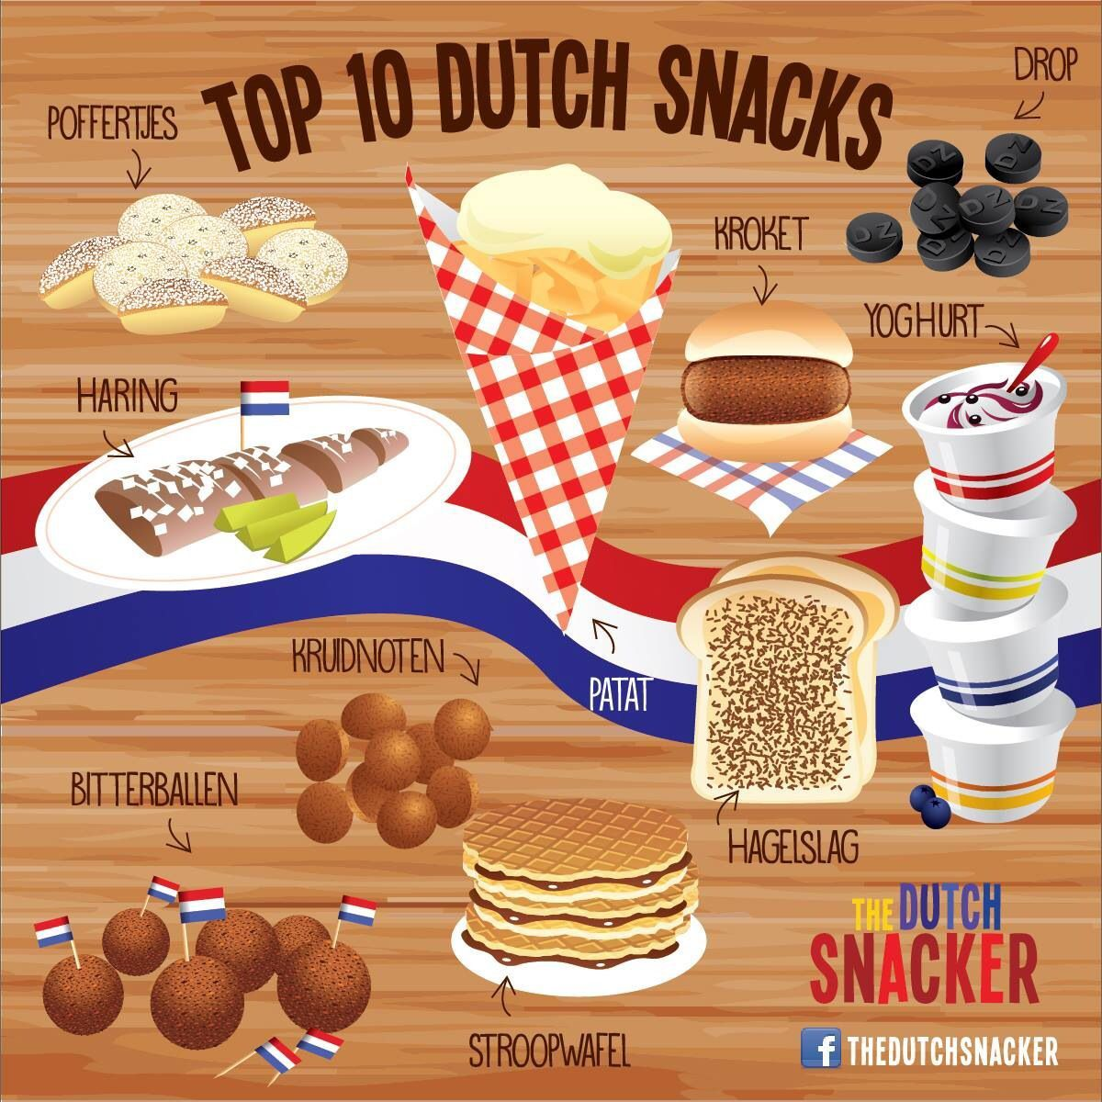
Food and drinks
Cheese
‘Stamppot’
Beer
Peanutbutter

Slide 5
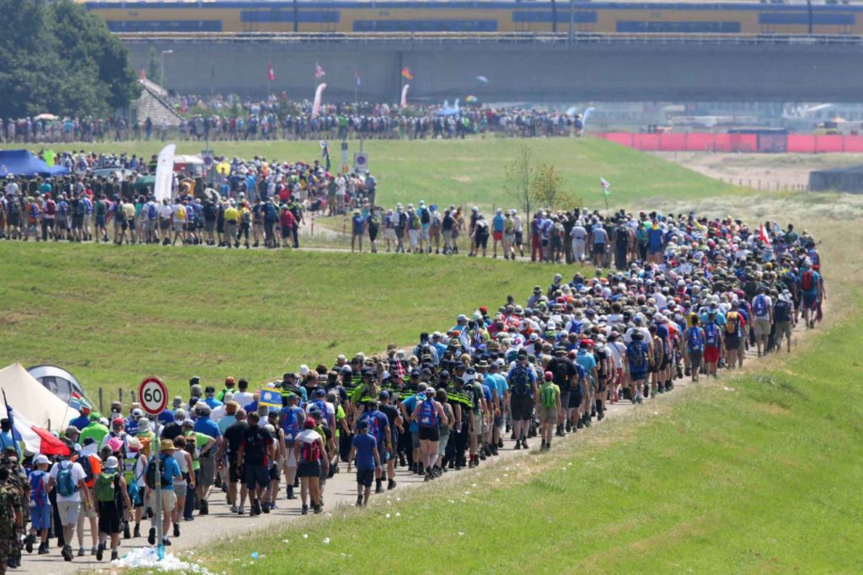
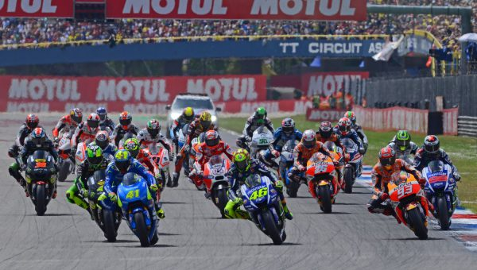
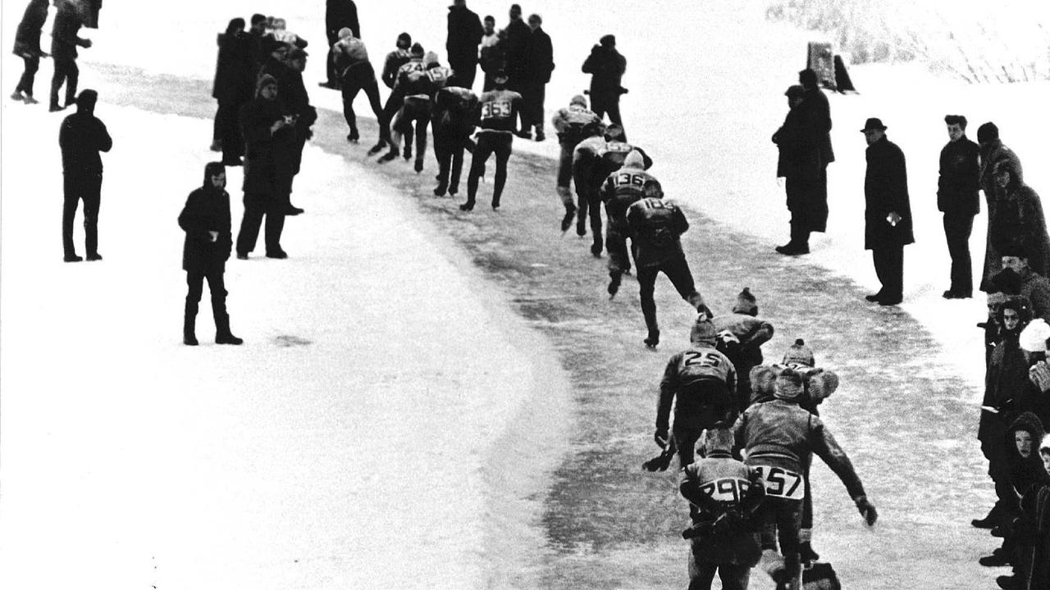
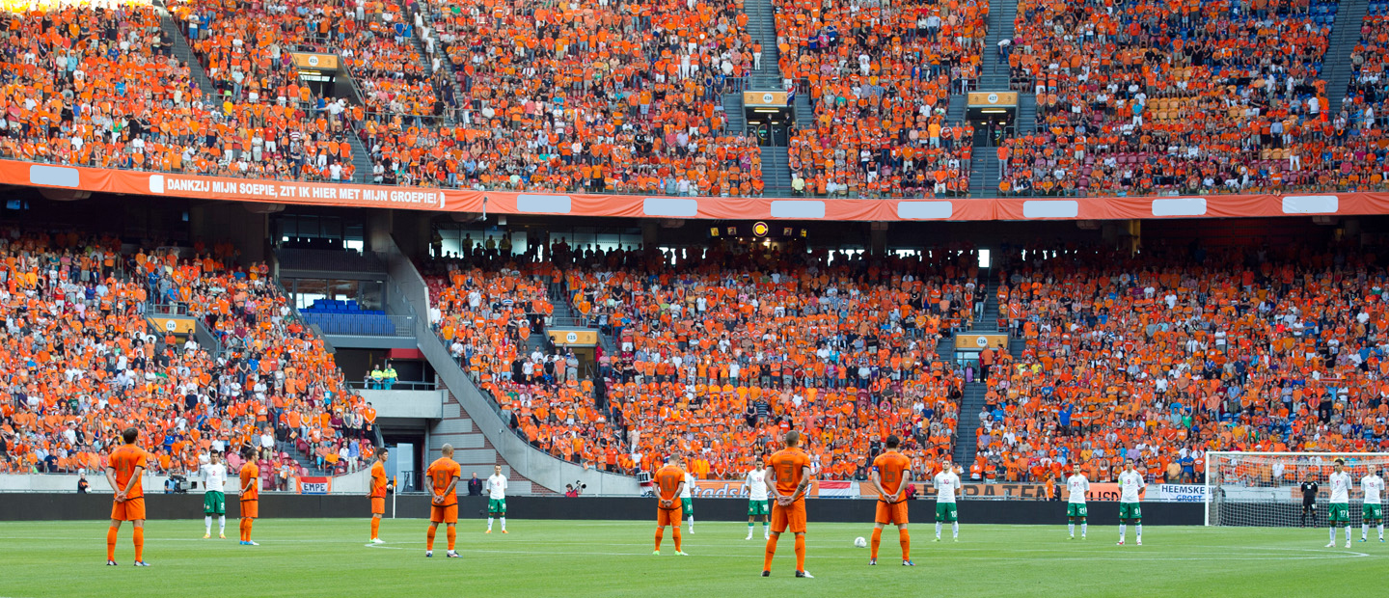
Sports
Soccer
‘Elfsteden tocht’
Oranje legioen
4 daagse van Nijmegen
Johan Cruyff
TT Assen

Slide 6
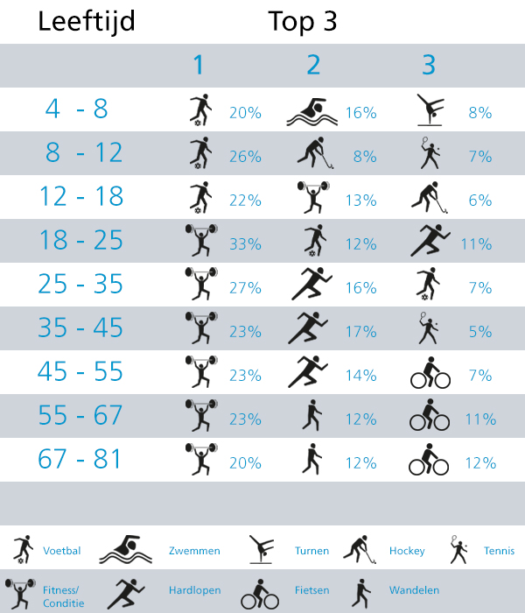
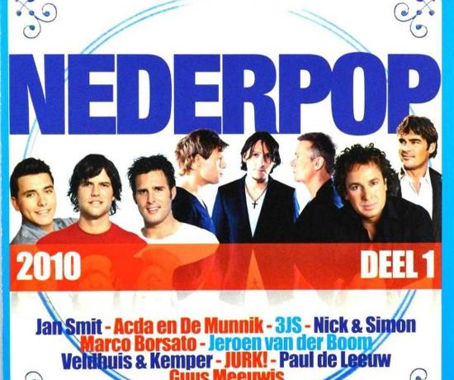
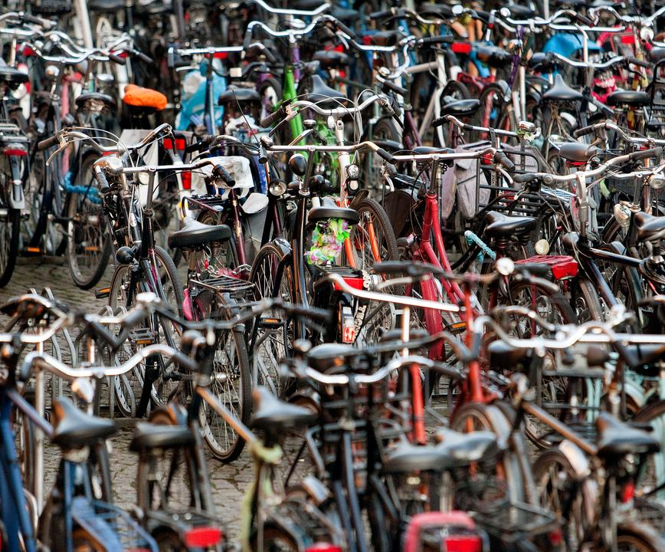
Typical dutch culture aspects
Freedom of speech
Cycling
Nederpop
Top 3 of sports

Slide 7
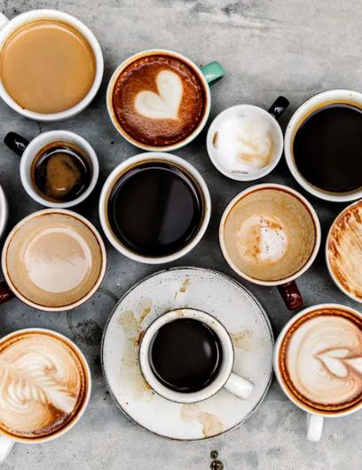
Culture on the workfloor
Coffeeeeeee
Respect
Hard workers
We say what we feel

Slide 8
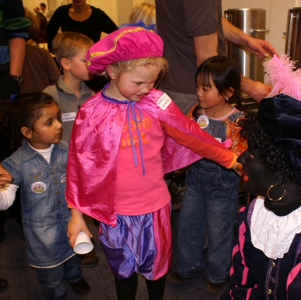
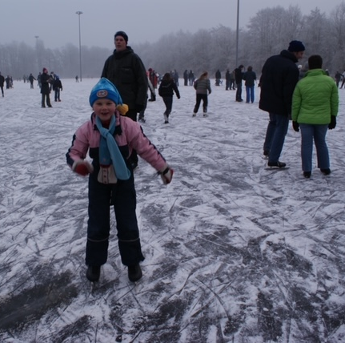
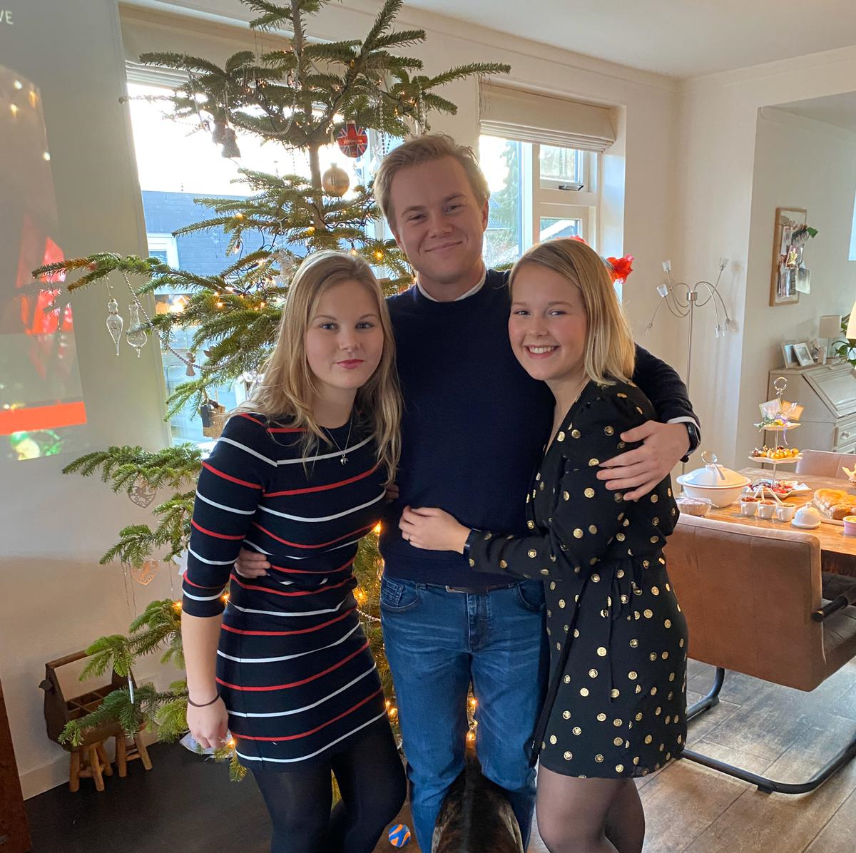
Me and my culture

